Slide 1
CS 540 Computer Networks II
Sandy Wang
sandy.w@svuca.edu

Slide 2
2. LAN Switching
Notes:
In this chapter, we look at the underlying technology and protocol architecture
of LANs. Chapters 12 and 13 are devoted to a discussion of specific
LAN systems.

Slide 3
Topics
Overview
LAN Switching
IPv4
IPv6
Tunnels
Routing Protocols -- RIP, RIPng
Routing Protocols -- OSPF
IS-IS
Midterm Exam
BGP
MPLS
Transport Layer -- TCP/UDP
Congestion Control & Quality of Service (QoS)
Access Control List (ACL)
Final Exam

Slide 4
Reference Books
Routing TCP/IP Volume I, 2nd Edition by Jeff Doyle and Jennifer Carroll
ISBN: 1-57870-089-2
Routing TCP/IP Volume II by Jeff Doyle and Jennifer DeHaven ISBN: 1-57870-089-2
Cisco CCNA Routing and Switching ICND2 200-101 Official Cert Guide, Academic Edition by Wendel Odom -- July 10, 2013. ISBN-13: 978-1587144882
The TCP/IP Guide: A Comprehensive, Illustrated Internet Protocols Reference by Charles M. Kozierok – October 1, 2005. ISBN-13: 978-1593270476
CCNA Routing and Switching 200-120 Network Simulator. By Wendell Odom, Sean Wilkins. Published by Pearson IT Certification.
http://class.svuca.edu/~sandy/class/CS540/

Slide 5
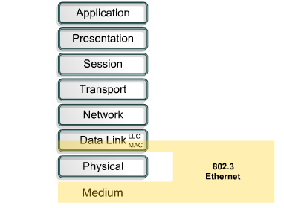
Ethernet and the OSI Model

Slide 6
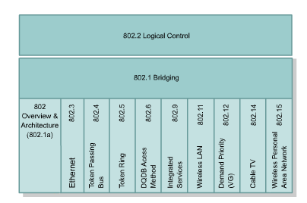
Ethernet and the OSI Model

Slide 7
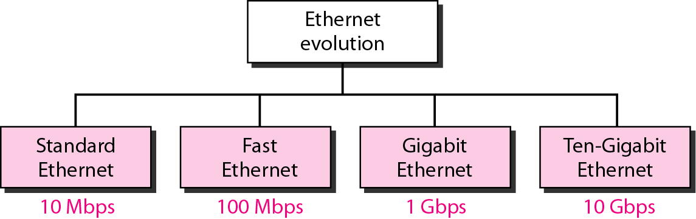
Figure 13.3 Ethernet evolution through four generations

Slide 8
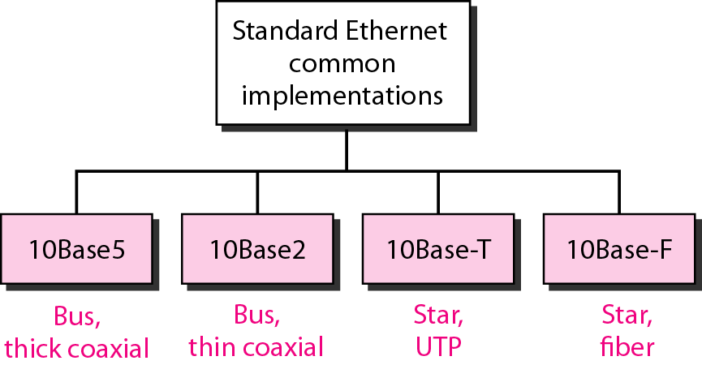

Categories of traditional Ethernet
<data rate><Signaling method><Max segment length or cable type>

Slide 9
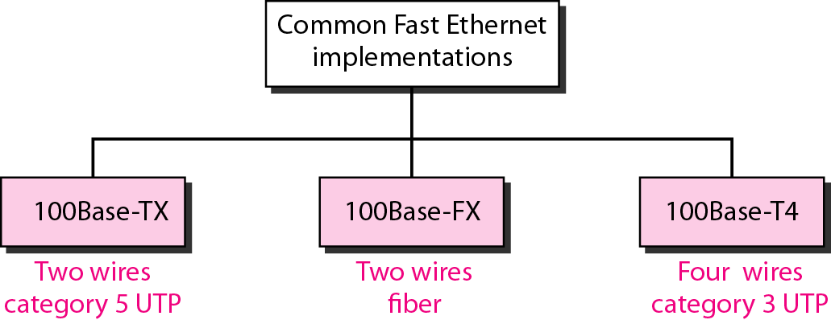
Fast Ethernet implementations

Slide 10
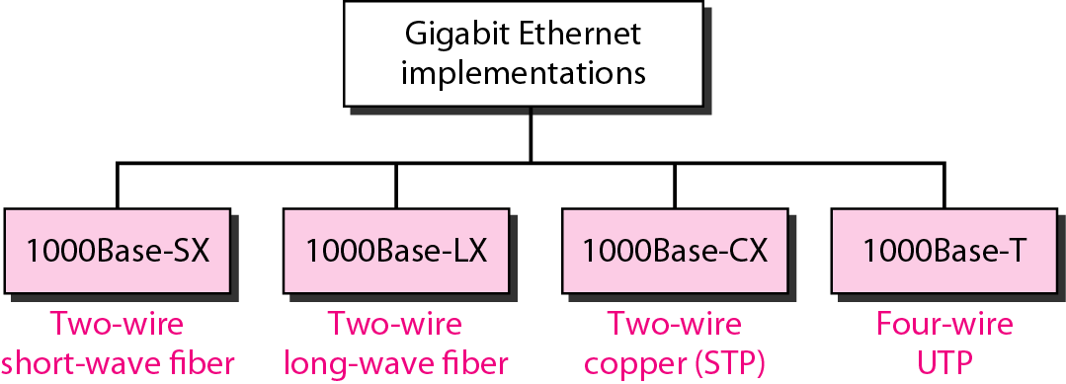
Gigabit Ethernet implementations

Slide 11
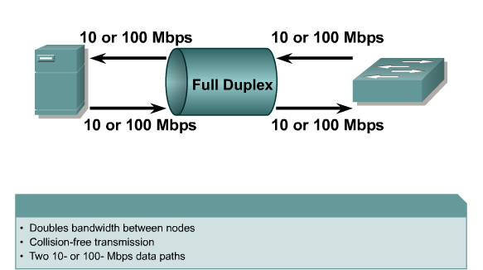
Full Duplex

Slide 12
Switch Modes
Store and Forward - A switch receives the entire frame before sending it out the destination port.
Cut-Through - A switch starts to transfer the frame as soon as the destination MAC address is received.

Slide 13
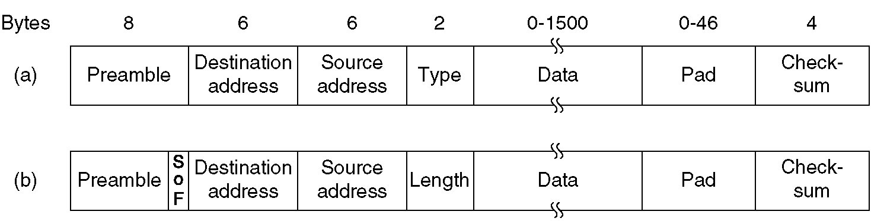
Ethernet Frame Format
FCS
FCS
Frame formats. (a) DIX Ethernet , (b) IEEE 802.3.

Slide 14
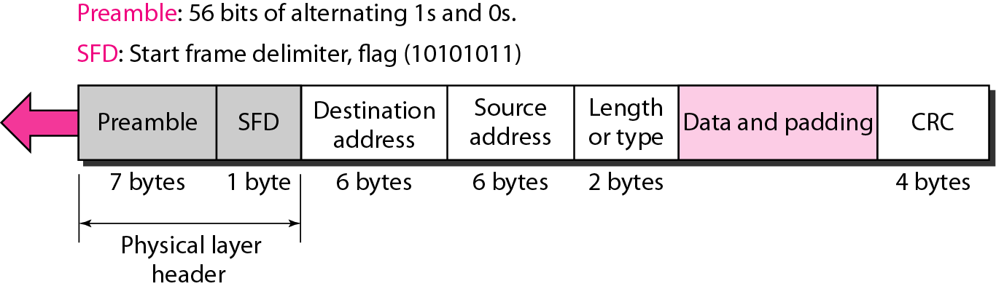
802.3 MAC frame
Length/Type – Length if less than 0x0600, otherwise protocol type
If less than 46 bytes data, padding is required

Slide 15
Ethernet Frame
Preamble:
8 bytes with pattern 10101010 used to synchronize receiver, sender clock rates.
In IEEE 802.3, eighth byte is start of frame (10101011)
Addresses: 6 bytes (explained latter)
Type (DIX)
Indicates the type of the Network layer protocol being carried in the payload field such as IP (0800), Novell IPX (8137) and AppleTalk (809B), ARP (0806) )
Allow multiple network layer protocols to be supported on a single machine (multiplexing)
Its value starts at 0600h (=1536 in decimal)
Length (IEEE 802.3): number of bytes in the data field.
Maximum 1500 bytes (= 0x5DC)
CRC: checked at receiver, if error is detected, the frame is discarded
Data: carries data encapsulated from the upper-layer protocols
Pad: Zeros are added to the data field to make the minimum data length = 46 bytes

Slide 16
Ethernet Provides Unreliable, connectionless Service
Ethernet data link layer protocol provides connectionless service to the network layer
No handshaking between sending and receiving adapter.
Ethernet protocol provides Unreliable service to the network layer :
Receiving adapter doesn’t send ACK or NAK to sending adapter
This means stream of datagrams passed to network layer can have gaps (missing data)
Gaps will be filled if application is using reliable transport layer protocol
Otherwise, application will see the gaps

Slide 17

Ethernet address
6 bytes = 48 bits
Flat address not hierarchical
Burned into the NIC ROM
First three bytes from left specify the vendor. Cisco 00-00-0C, 3Com 02-60-8C and the last 24 bit should be created uniquely by the company
Destination Address can be:
Unicast: second digit from left is even (one recipient)
Multicast: Second digit from left is odd (group of stations to receive the frame – conferencing applications)
Broadcast (ALL ones) (all stations receive the frame)
Source address is always Unicast

Slide 18
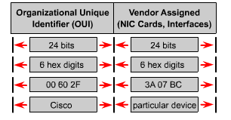
Naming

Slide 19

Note
The least significant bit of the first byte defines the type of address. If the bit is 0, the address is unicast; otherwise, it is multicast.

Slide 20
Note
The broadcast destination address is a special case of the multicast address in which all bits are 1s.

Slide 21
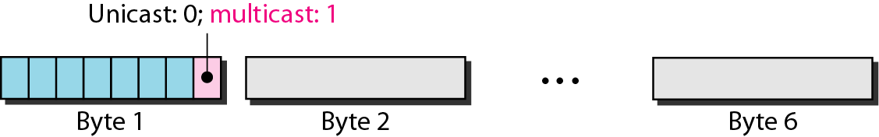
Figure 13.7 Unicast and multicast addresses

Slide 22
Example 13.1
Define the type of the following destination addresses:
4A:30:10:21:10:1A
47:20:1B:2E:08:EE
FF:FF:FF:FF:FF:FF
Solution
To find the type of the address, we need to look at the second hexadecimal digit from the left. If it is even, the address is unicast. If it is odd, the address is multicast. If all digits are F’s, the address is broadcast. Therefore, we have the following:
a. This is a unicast address because A in binary is 1010.
b. This is a multicast address because 7 in binary is 0111.
c. This is a broadcast address because all digits are F’s.

Slide 23
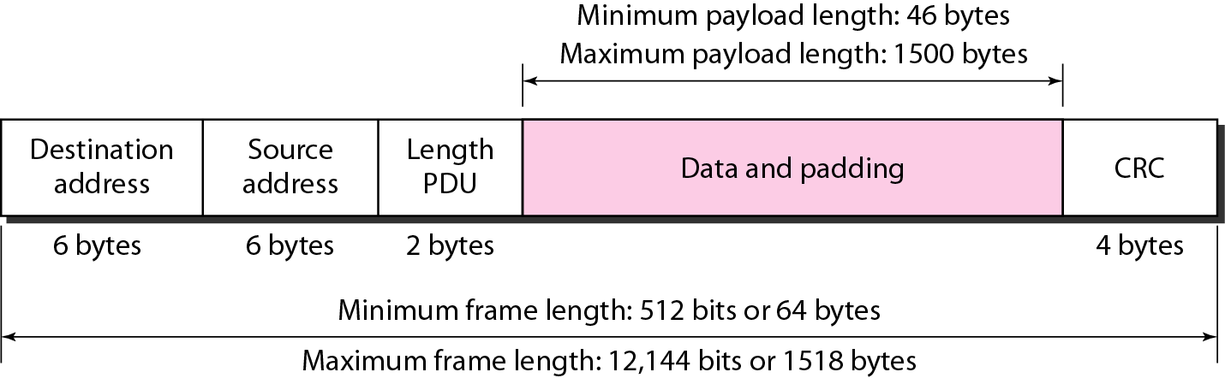
Figure 13.5 Minimum and maximum lengths

Slide 24
Note
Frame length:
Minimum: 64 bytes (512 bits) Maximum: 1518 bytes (12,144 bits)

Slide 25
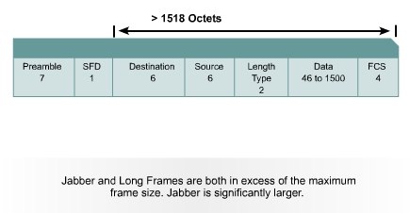
Ethernet Errors

Slide 26
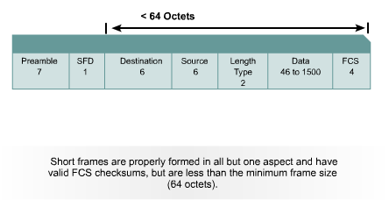
Ethernet Errors

Slide 27
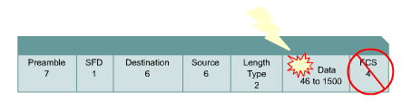
FCS Errors

Slide 28
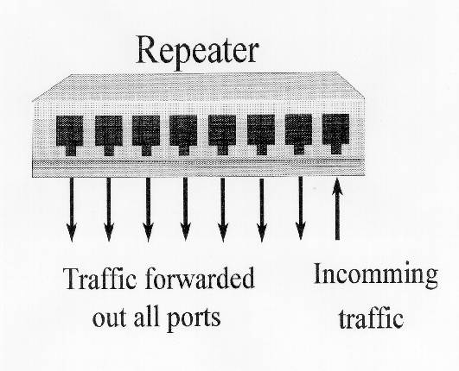
Sending and receiving Ethernet frames via a hub
Hub or

Slide 29
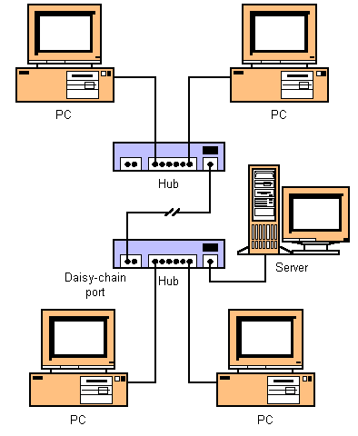

Sending and receiving Ethernet frames via a hub
3333
1111
So, what does a hub do when it receives information?
Remember, a hub is nothing more than a multiport repeater.
1111
?
2222
5555
3333
4444

Slide 30

Sending and receiving Ethernet frames via a hub
3333
1111
The hub will flood it out all ports except for the incoming port.
Hub is a layer 1 device.
A hub does NOT look at layer 2 addresses, so it is fast in transmitting data.
Disadvantage with hubs: A hub or series of hubs is a single collision domain.
A collision will occur if any two or more devices transmit at the same time within the collision domain.
More on this later.
1111
2222
Nope
5555
Nope
3333
For me!
4444
Nope

Slide 31
Sending and receiving Ethernet frames via a hub
2222
1111
1111
2222
Another disadvantage with hubs is that is take up unnecessary bandwidth on other links.
For me!
5555
Wasted bandwidth
Nope
3333
Nope
4444
Nope

Slide 32
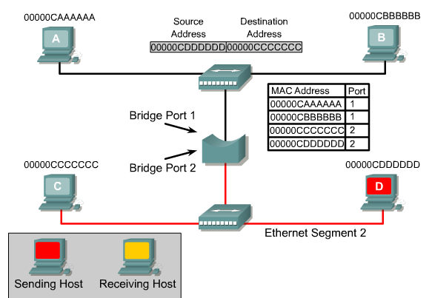
Layer 2 Bridging

Slide 33
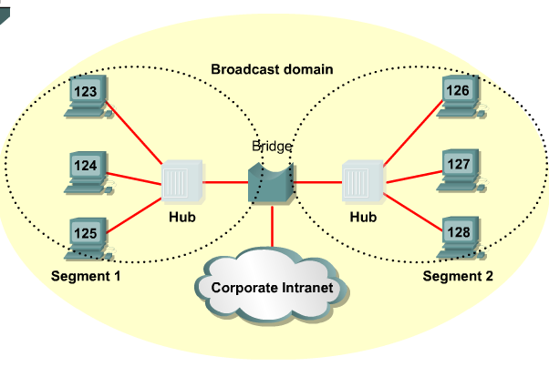
Bridges

Slide 34
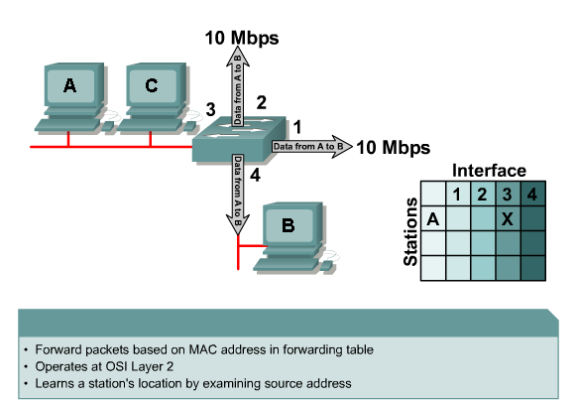
Switch Operation

Slide 35
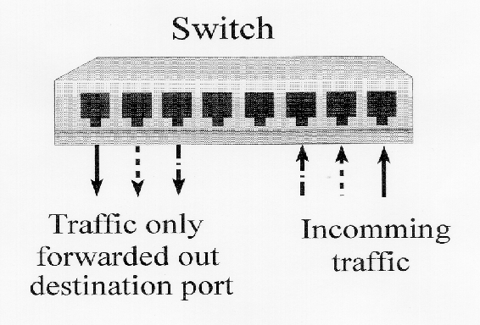
Sending and receiving Ethernet frames via a switch

Slide 36


Sending and receiving Ethernet frames via a switch
Source Address Table
Port Source MAC Add. Port Source MAC Add.
3333
1111
Switches are also known as learning bridges or learning switches.
A switch has a source address table in cache (RAM) where it stores source MAC address after it learns about them.
A switch receives an Ethernet frame it searches the source address table for the Destination MAC address.
If it finds a match, it filters the frame by only sending it out that port.
If there is not a match if floods it out all ports.
switch
1111
3333
Abbreviated MAC addresses
2222
4444

Slide 37
No Destination Address in table, Flood
Source Address Table
Port Source MAC Add. Port Source MAC Add.
1 1111
3333
1111
How does it learn source MAC addresses?
First, the switch will see if the SA (1111) is in it’s table.
If it is, it resets the timer (more in a moment).
If it is NOT in the table it adds it, with the port number.
Next, in our scenario, the switch will flood the frame out all other ports, because the DA is not in the source address table.
switch
1111
3333
Abbreviated MAC addresses
2222
4444

Slide 38
Destination Address in table, Filter
Source Address Table
Port Source MAC Add. Port Source MAC Add.
1 1111 6 3333
1111
3333
Most communications involve some sort of client-server relationship or exchange of information. (You will understand this more as you learn about TCP/IP.)
Now 3333 sends data back to 1111.
The switch sees if it has the SA stored.
It does NOT so it adds it. (This will help next time 1111 sends to 3333.)
Next, it checks the DA and in our case it can filter the frame, by sending it only out port 1.
switch
1111
3333
Abbreviated MAC addresses
2222
4444

Slide 39
Destination Address in table, Filter
Source Address Table
Port Source MAC Add. Port Source MAC Add.
1 1111 6 3333
3333
1111
switch
1111
3333
Now, because both MAC addresses are in the switch’s table, any information exchanged between 1111 and 3333 can be sent (filtered) out the appropriate port.
1111
3333
Abbreviated MAC addresses
2222
4444

Slide 40
Frame Forwarding
Maintain forwarding database for each port attached to a LAN
For a frame arriving on port X:
Search forwarding database to see if MAC address is listed for any port except port X
If destination MAC address is not found, forward frame out all ports except the one from which it was received
If the destination address is in the forwarding database for some port y, check port y for blocking or forwarding state
If port y is not blocked, transmit frame through port y onto the LAN to which that port attaches
Notes:
In this scheme, a bridge maintains a forwarding database for
each port attached to a LAN. The database indicates the station addresses for which
frames should be forwarded through that port. We can interpret this in the following
fashion. For each port, a list of stations is maintained. A station is on the list
if it is on the “same side” of the bridge as the port. For example, for bridge 102 of
Figure 11.8, stations on LANs C, F, and G are on the same side of the bridge as
the LAN C port, and stations on LANs A, B, D, and E are on the same side of the
bridge as the LAN A port. When a frame is received on any port, the bridge must
decide whether that frame is to be forwarded through the bridge and out through
one of the bridge’s other ports. Suppose that a bridge receives a MAC frame on
port x .
The following rules are applied:
1. Search the forwarding database to determine if the MAC address is listed for
any port except port x .
2. If the destination MAC address is not found, forward frame out all ports
except the one from which it was received. This is part of the learning process
described subsequently.
3. If the destination address is in the forwarding database for some port y, then
determine whether port y is in a blocking or forwarding state. For reasons
explained later, a port may sometimes be blocked, which prevents it from
receiving or transmitting frames.
4. If port y is not blocked, transmit the frame through port y onto the LAN to
which that port attaches.

Slide 41
Address Learning
Can preload forwarding database
When frame arrives at port X, it has come from the LAN attached to port X
Use source address to update forwarding database for port X to include that address
Have a timer on each entry in database
If timer expires, entry is removed
Each time frame arrives, source address checked against forwarding database
If present timer is reset and direction recorded
If not present entry is created and timer set
Notes:
The preceding scheme assumes that the bridge is already equipped with a forwarding database that indicates the direction, from the bridge, of each destination station. This information can be preloaded into the bridge, as in fixed routing. However, an effective automatic mechanism for learning the direction of each station is desirable. A simple scheme for acquiring this information is based on the use of the source address field in each MAC frame.
The strategy is this. When a frame arrives on a particular port, it clearly has come from the direction of the incoming LAN. The source address field of the frame indicates the source station. Thus, a bridge can update its forwarding database for that port on the basis of the source address field of each incoming frame. To allow for changes in topology, each element in the database is equipped with a timer. When a new element is added to the database, its timer is set. If the timer expires, then the element is eliminated from the database, since the corresponding direction information may no longer be valid. Each time a frame is received, its source address is checked against the database. If the element is already in the database, the entry is updated (the direction may have changed) and the timer is reset. If the element is not in the database, a new entry is created, with its own timer.

